Slide 1
MEASUREMENT OF THE AERODYNAMIC DRAG OF TEXTILES WITH A NOVEL DEVICE
Schindelwig, K.¹, Hasler, M.², Nachbauer, W.¹,
van Putten, J.², Knoflach, C.²
¹⁾ Department of Sport Science, University of Innsbruck, Austria
²⁾ Centre of Technology of Ski- and Alpine Sport

Slide 2
Introduction
Aerodynamic is important for high speed sports
speed skating, cycling, skiing…
(Chowdhury et al., 2010; Oggiano et al. 2009, D’Auteuil et al. 2010).
Aerodynamic drag influenced through textiles
e.g. surface roughness
Drag measurement of textiles
only with wind tunnel experiments (drawback - high costs)
(Brownlie et al., 2010, Chowdhury et al., 2010)

Slide 3
Goal
Aerodynamic drag measurement in a wide range of velocities
Reliability of the novel measurement device
Comparison
Novel measurement device - Wind tunnel
Influence of surface roughness
smooth – rough surface textiles
Influence of temperature
-16°C to 16°C

Slide 4
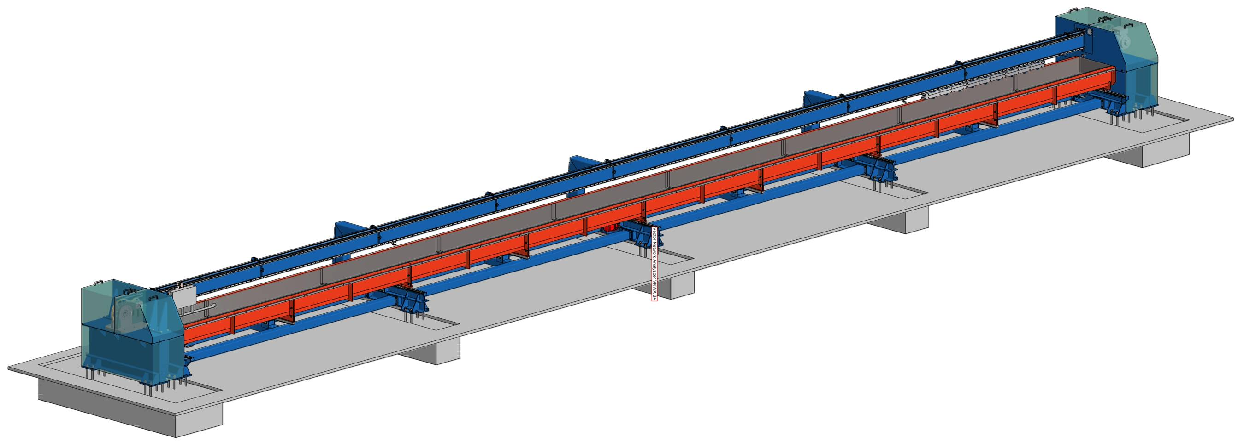
Method: Novel linear measurement device
high torque
electro motor
(80 kW)
25 m guidance beam
fibre cable
carriage

Slide 5
Method: Data acquisition devices
Cylinder with textiles:
60 cm height
15 cm diameter
inductive length
measurement
system
carriage
40 cm
load
cells

Slide 6
Method: Data acquisition devices

Slide 7
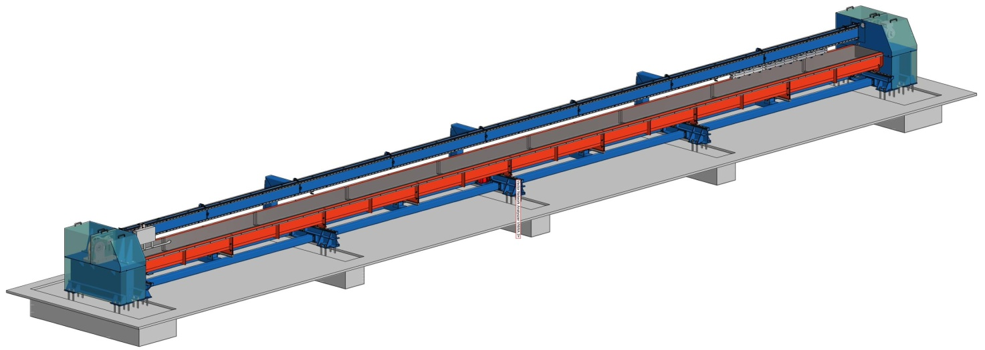
Method: Cooling chamber
Temperature range from:
-30°C to 30°C

Slide 8
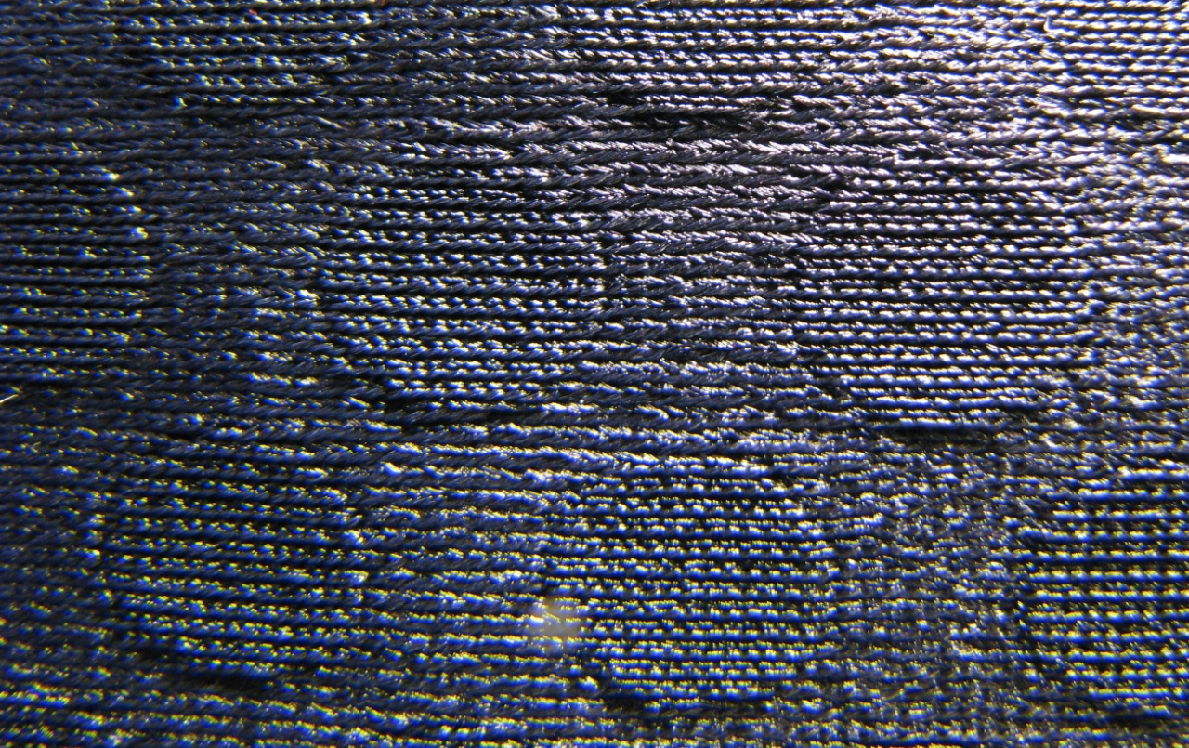
Method: Smooth and Rough textiles
1 cm

Slide 9
Method
Linear measurement system
Both textiles 10 times
at each speed
5 – 20 m/s; step size 1 m/s
at -16°C and 16°C
Aeroacustic wind tunnel (Audi, Ingolstadt, Germany)
Both textiles 2 times
at each speed
8.3 – 38.8 m/s; step size 2.7 m/s
at 24°C

Slide 10
Method: Calculation
v velocity cylinder
a acceleration cylinder
F_{i} = m $∙$ a F_{i} inertia force cylinder
m mass cylinder
F_{D} = F_{m} $−$ F_{i} F_{D} drag force
F_{m} measured force
C_{D} = $\frac{ρ∙ A ∙ v^{2}}{2 ∙FD}$ C_{D} drag coefficient
$ρ$ density of air; A frontal area,

Slide 11
Results: Velocity

Slide 12
Results: Forces at 5 m/s
F_{D} = F_{m} $−$ F_{a}

Slide 13
Results: Range of 10 trials

Slide 14
Results: wind tunnel – novel m. d.

Slide 15
Results: temperature

Slide 16
Results: summary
Reliability
novel linearmeasurement device
mean range 10 measurements +/- 2.4%.
wind tunnel
mean range 10 measurements +/- 10%.
Comparison
good agreement wind tunnel – novel measurement system
mean difference 6%
Influence of surface roughness
same as in literature (smooth surface - rough surface)
Influence of temperature
smooth surface higher than rough surface

Slide 17
Conclusion
With the novel linear measurement system we have developed a accuracy possibility to determine the drag of textiles from speeds between 5 to 20 m/s and the great advantage is that the costs are low.
In future we also want to determine the lift with the novel linear measurement system on the cylinder with different angle of attack.

Slide 18
Method: Calculation
Reynolds Zahl
Re = $\frac{ρ∙v∙d}{η}$ velocity and acceleration cylinder
$η={10}^{−5}(1.723+0.0047∙$ T)

Slide 19
Results
The circular cylinder is one of the most common bluff body shapes with round edges. Cylinder aerodynamics has
received a lot of attention from researchers for decades, yet remains inadequately understood. The three main
aerodynamic regimes as denoted by where the transition from laminar to turbulent flow occurs have been described in detail in Zdravkovich [1]. At low Reynolds number, the transition happens in the wake, TrW, then the transition moves forward to the shear layer, TrSL, and by increasing the Reynolds number up to 1x10
5, the transition takesplace in the boundary layer, TrBL, where an important reduction of the drag is observed which defines the critical Reynolds number range for a circular cylinder. The left side of Figure 1 shows the aerodynamic force coefficients
and especially the drag coefficient (C D ) as a function of Reynolds number for a smooth circular cylinder with the
three distinct regimes and the important drag reduction in the TrBL regime.

Slide 20
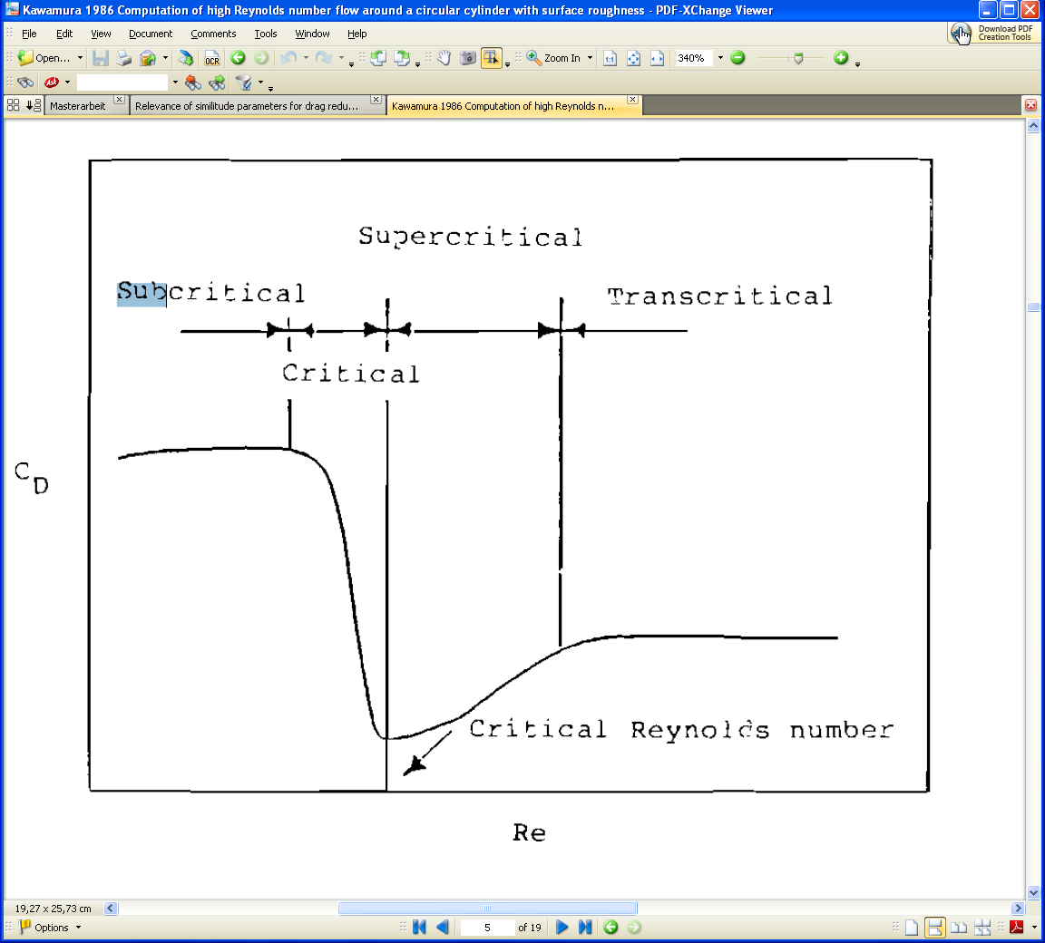
Results

Slide 21
Results

Slide 22
Results
The friction drag results from the friction between the air and the athlete and is represented by a viscous boundary layer at the surface of the athlete's garment. The pressure drag results from the difference in pressure between the windward and leeward area of the athlete along the direction of the flow. When separation of the shear layer occurs, pressure drag
dominates over friction drag which defines the ‘bluff body’ aerodynamics category.

Slide 23
Results
The friction drag results from the friction between the air and the athlete and is represented by a viscous boundary layer at the surface of the athlete's garment. The pressure drag results from the difference in pressure between the windward and leeward area of the athlete along the direction of the flow. When separation of the shear layer occurs, pressure drag
dominates over friction drag which defines the ‘bluff body’ aerodynamics category.

Slide 24
Method: Sensors
Linear measurement system
Position measurement Device
(LMB-130.2, LMK 132-Z-1.6.0AMO, Austria)
Resolution: 0.01 mm
distance date smoothed with a quintic spline (0.001)
Force measurement Device
(HBM Wägemesszelle…)
Range
Aeroacustic wind tunnel (Audi, Ingolstadt, Germany)
Force measurement with a internal force plate

